Slide 1
T-tests and Association
MCB 293S:
Foundations of Biostatistical Practice
Week 3
Kelly Street
PhD Candidate
Division of Biostatistics
Dr. Sandrine Dudoit
Department of Statistics
Division of Biostatistics

Slide 2
The t-distribution
What it is and why we need it.

Slide 3
Standardizing
For any value believed to come from a normal distribution, we can standardize it to have a mean of 0 and a variance of 1:
This can be thought of as measuring distance in terms of standard deviations, rather than the original units.

Slide 4
T-distributions
This is how we deal with the additional uncertainty from estimating (rather than knowing) the variance. All t-distributions meant to be compared to the standard normal curve (with mean = 0 and variance = 1). Rather than a mean and variance, we identify them based on the number of degrees of freedom.

Slide 5
a/b testing
How do we compare two different samples?

Slide 6
Setup
We have two groups of observations, unpaired and not necessarily the same number of each.
Do these two groups have the same mean?

Slide 7
Setup
Assume:
Find a distribution for:

Slide 8
Permutation Test
“Modern”
Represent the data as two columns.
We are interested in testing whether or not the two columns are independent.
Whatever association exists between the values and the labels, we break it by shuffling the labels. This ensures that the theoretical mean of the two groups is the same and any observed differences are due to random chance.
This produces a new difference of means. Repeating this process gives us a distribution.
Value
Label
10.1
14.5
8.5
12.8
.
.
.
11.2
15.8
14.0
17.1
1
1
1
1
.
.
.
2
2
2
2
2
1
1
2
.
.
.
1
1
1
2
2
1
2
2
.
.
.
2
2
1
1
2
2
1
2
.
.
.
1
2
1
2

Slide 9
Permutation Test
“Modern”
Pick a large number of permutations
(10,000 shown here).
How many values are “more extreme” than our observed value?
95 out of 10,000
p-value = .0095
p-value < .01

Slide 10
Permutation Test
“Modern”
This works with ANY statistic,
not just the mean!
Value
Label
10.1
14.5
8.5
12.8
.
.
.
11.2
15.8
14.0
17.1
2
2
1
2
.
.
.
1
2
1
2
p-value = 0.837

Slide 11
Two-Sample T-test
“Classical”
Find the theoretical distribution for the sample difference, assuming the true difference is zero.
The sum (or difference) of normally distributed random variables will also be normally distributed.
Specifically, if
then

Slide 12
Two-Sample T-test
“Classical”
Find the theoretical distribution for the sample difference, assuming the true difference is zero.
Therefore
Or, assuming the null hypothesis
So, all we need to do is to estimate the variances of the two groups.

Slide 13
Two-Sample T-test
“Classical”
Estimate the variances in the usual way, separately for each group.
8.116598
8.640861
Now we have an estimate for the variance of the difference in means:
0.3483222
But, this is going to be a T-test, so how many degrees of freedom?

Slide 14
Two-Sample T-test
“Classical”
We ALSO have to estimate the number of degrees of freedom!
The Satterthwaite approximation:
84.44833

Slide 15
Two-Sample T-test
“Classical”
Finally, we are ready to compute the
t-statistic and compare to the reference distribution we worked so hard to find.
As in the 1-sample case, we subtract off the (theoretical) mean and divide by the standard deviation.
-2.576276

Slide 16
Two-Sample T-test
“Classical”
Finally, we are ready to compute the
t-statistic and compare to the reference distribution we worked so hard to find.
Observed difference
T-distribution with 84.44833 degrees of freedom
p-value = 0.0117

Slide 17
Two-Sample T-test
“Classical”
The bad news: this ONLY tests for a difference in means.
(all three of these distributions have the same mean)

Slide 18
Two-Sample T-test
“Classical”
The good news: there’s an easy way to skip all the tedious calculation.
> t.test(sample1, sample2)
Welch Two Sample t-test
data: sample1 and sample2
t = -2.6044, df = 84.663, p-value = 0.01087
alternative hypothesis: true difference in means is not equal to 0
95 percent confidence interval:
-2.6813527 -0.3596234
sample estimates:
mean of x mean of y
13.01112 14.53161

Slide 19
Linear regression
Finding relationships
between continuous variables

Slide 20
Setup
We have two continuous variables, one designated as the “outcome,” and we want to know if there is a linear relationship between them.
Slope of the best-fit line:
Does the slope of the true line equal zero?

Slide 21
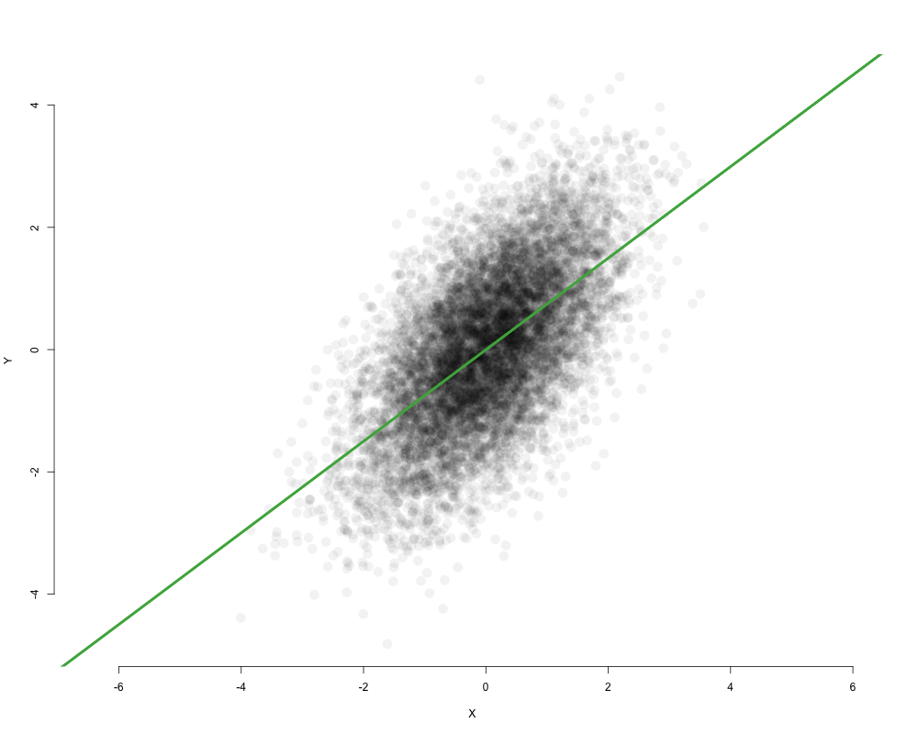
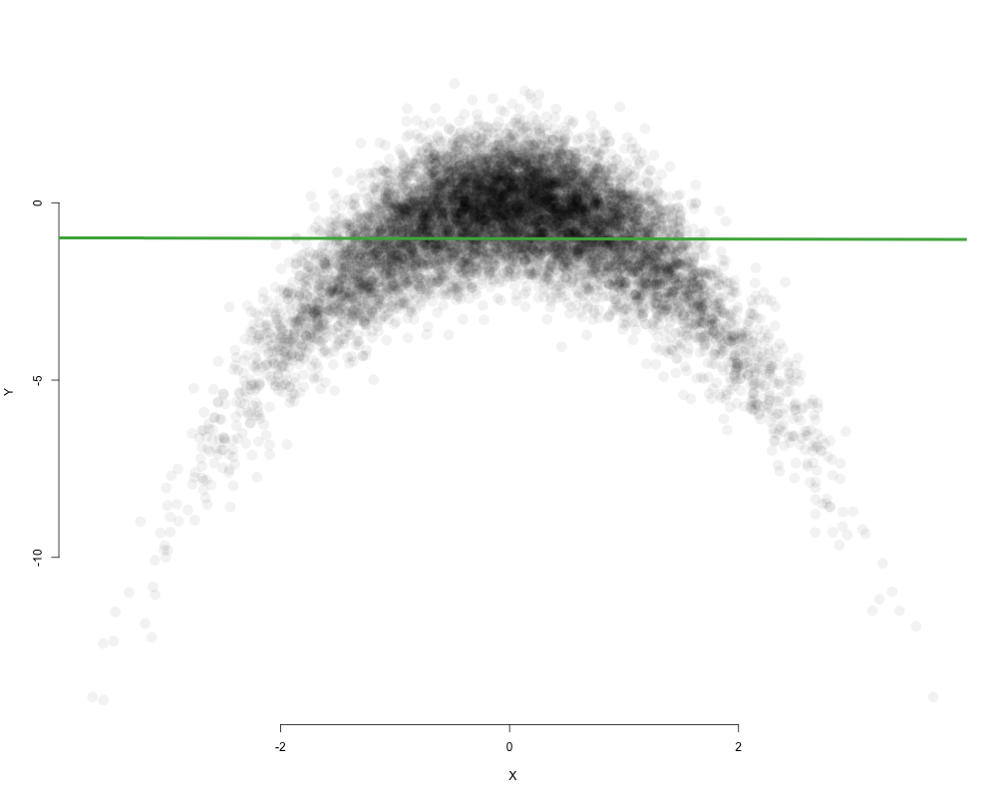
Setup
The true best-fit line is the line you would get with an infinite sample size.
This is not a perfect measure of association.
Even a true slope of zero does not mean the variables are independent.

Slide 22
Setup
“Best” means minimizing the total sum of squared errors in the outcome.

Slide 23
Setup
Describing the model:

Slide 24
Setup
“Classical”
Describing the model:

Slide 25
Distribution of the estimate
“Classical”
Some algebra:
Central Limit Theorem!

Slide 26
Distribution of the estimate
“Classical”
The estimate of the slope will follow a normal distribution, centered at the truth:
R will take care of this.
> lm(y ~ x)
Call:
lm(formula = y ~ x)
Coefficients:
(Intercept) x
-0.09836 0.70717
Notes:
N-1 DEGREES OF FREEDOM

Slide 27
Distribution of the estimate
“Classical”
> fit <- lm(y ~ x)
> summary(fit)
Call:
lm(formula = y ~ x)
Residuals:
Min 1Q Median 3Q Max
-1.92106 -0.79521 0.00594 0.51198 1.78129
Coefficients:
Estimate Std. Error t value Pr(>|t|)
(Intercept) -0.09836 0.13345 -0.737 0.465
x 0.70717 0.13820 5.117 5.41e-06 ***
---
Signif. codes: 0 ‘***’ 0.001 ‘**’ 0.01 ‘*’ 0.05 ‘.’ 0.1 ‘ ’ 1
Residual standard error: 0.9433 on 48 degrees of freedom
Multiple R-squared: 0.353, Adjusted R-squared: 0.3395
F-statistic: 26.18 on 1 and 48 DF, p-value: 5.405e-06

Slide 28
The Correlation Coefficient
Y
Opposite sign
(-)
Same sign
(+)
Same sign
(+)
Opposite sign
(-)
X

Slide 29
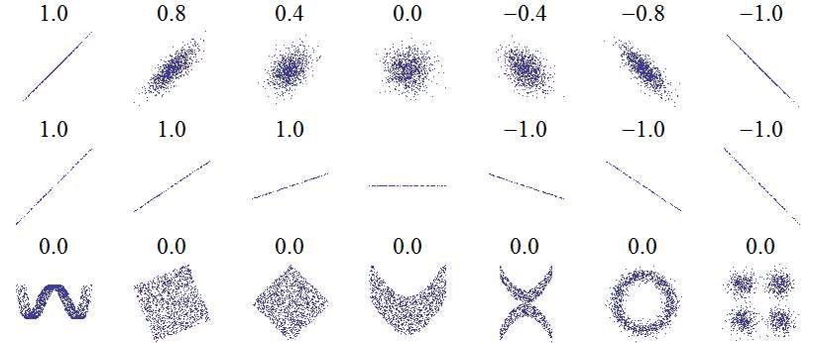
The Correlation Coefficient
https://en.wikipedia.org/wiki/Pearson_correlation_coefficient#/media/File:Correlation_examples2.svg
Notes:
NOTE: R-SQUARED = r SQUARED

Slide 30
Bootstrap (again)
“Modern”
Sample from the data (with replacement), calculate a new slope, repeat.

Slide 31
Bootstrap (again)
“Modern”
Sample from the data (with replacement), calculate a new slope, repeat.
This gives us a distribution of slopes which we can use for hypothesis testing and building confidence intervals.
95% Confidence Interval

Slide 32
Bootstrap (again)
“Modern”
Sample from the data (with replacement), calculate a new correlation coefficient, repeat.
95% Confidence Interval

Slide 33
Categorical Predictors
We have two groups of observations, unpaired and not necessarily the same number of each.
It’s all connected!!!

